Slide 1
Enrollment
Transfer

Slide 2
Error!
Please Follow the On-Screen
Instructions to Continue
Go Back

Slide 3
Complete
Please navigate to the next module
Within this course to continue
Start Over

Slide 4
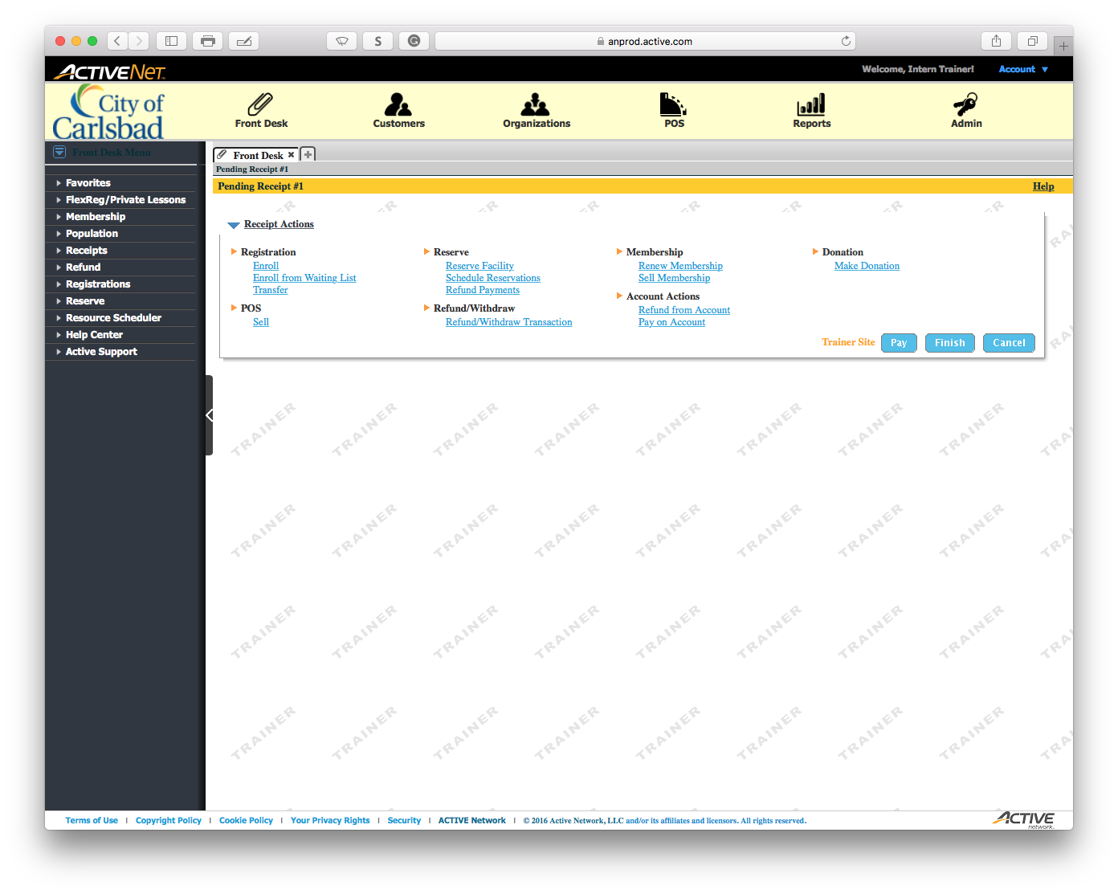
Main Text Instruction Will Go Here
Sub Instruction Here

Slide 5
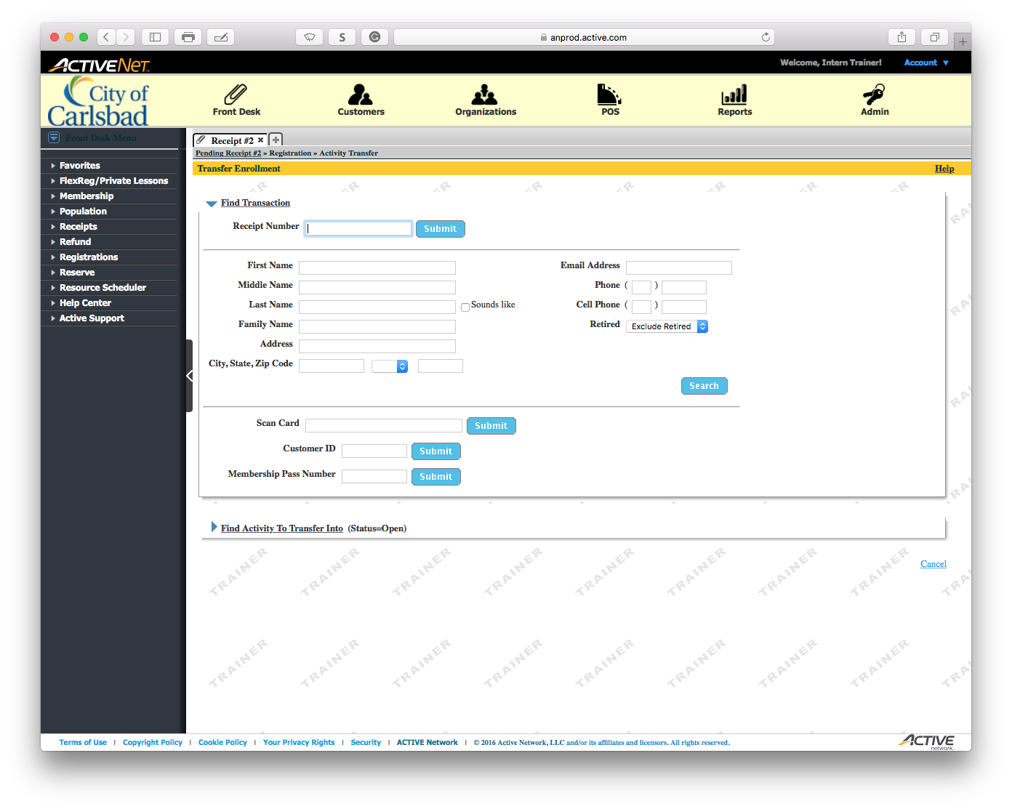
Main Text Instruction Will Go Here
Sub Instruction Here

Slide 6
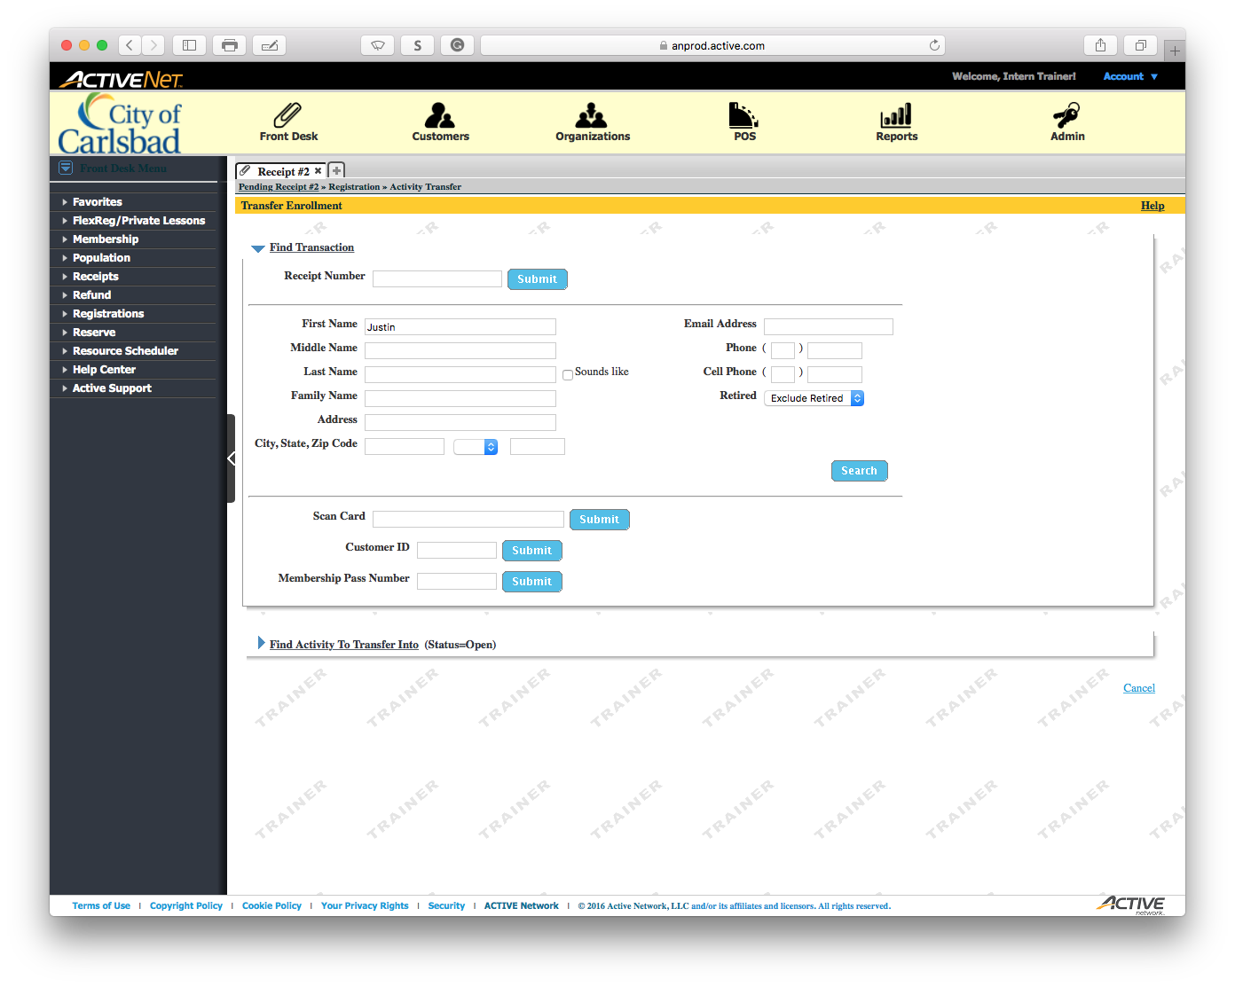
Main Text Instruction Will Go Here
Sub Instruction Here

Slide 7
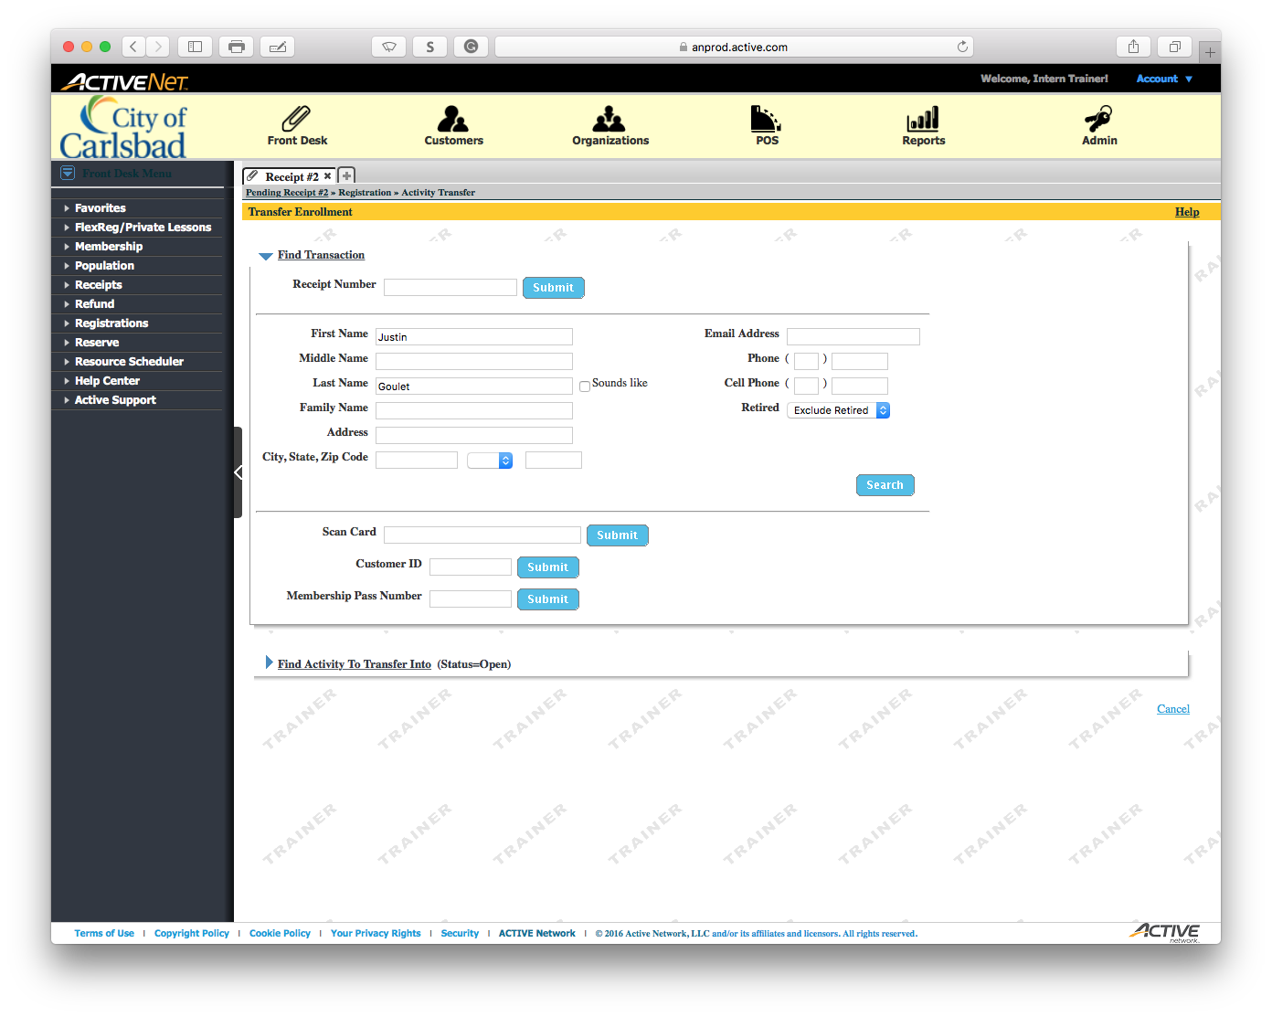
Main Text Instruction Will Go Here
Sub Instruction Here

Slide 8
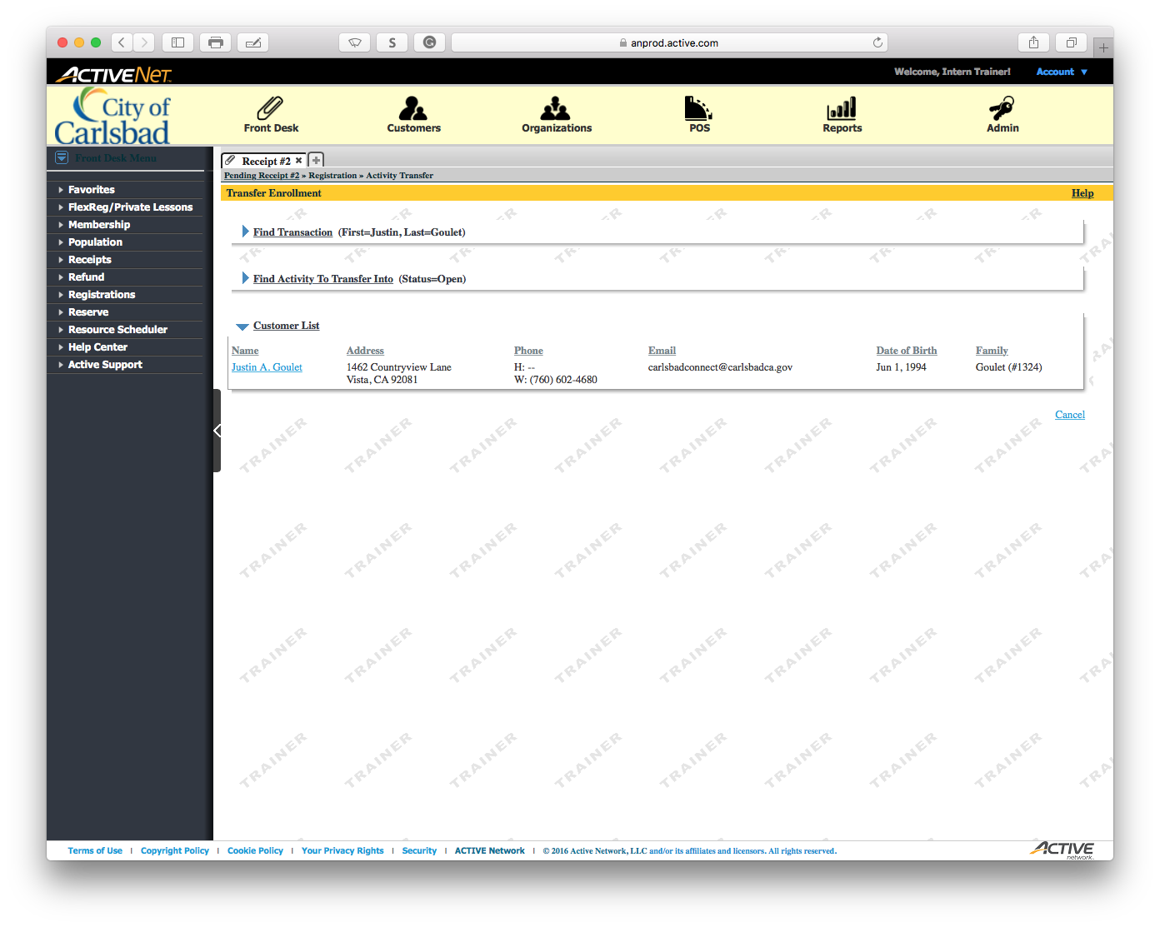
Main Text Instruction Will Go Here
Sub Instruction Here

Slide 9
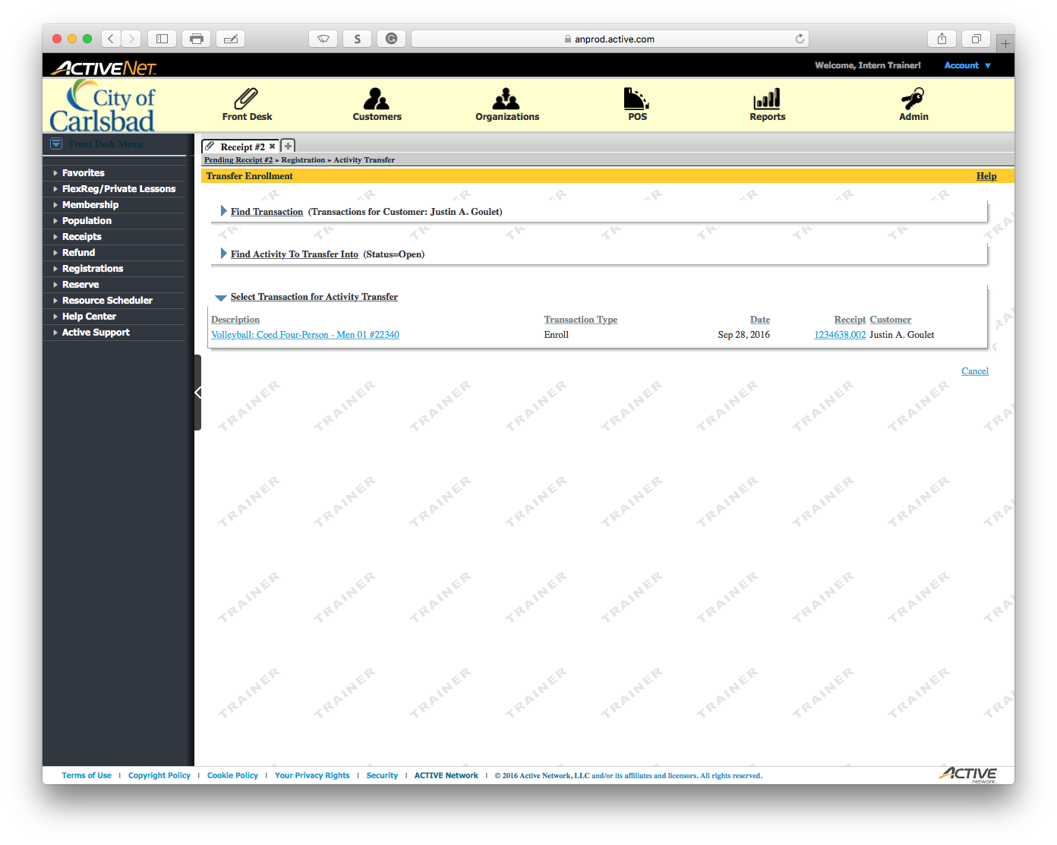
Main Text Instruction Will Go Here
Sub Instruction Here

Slide 10
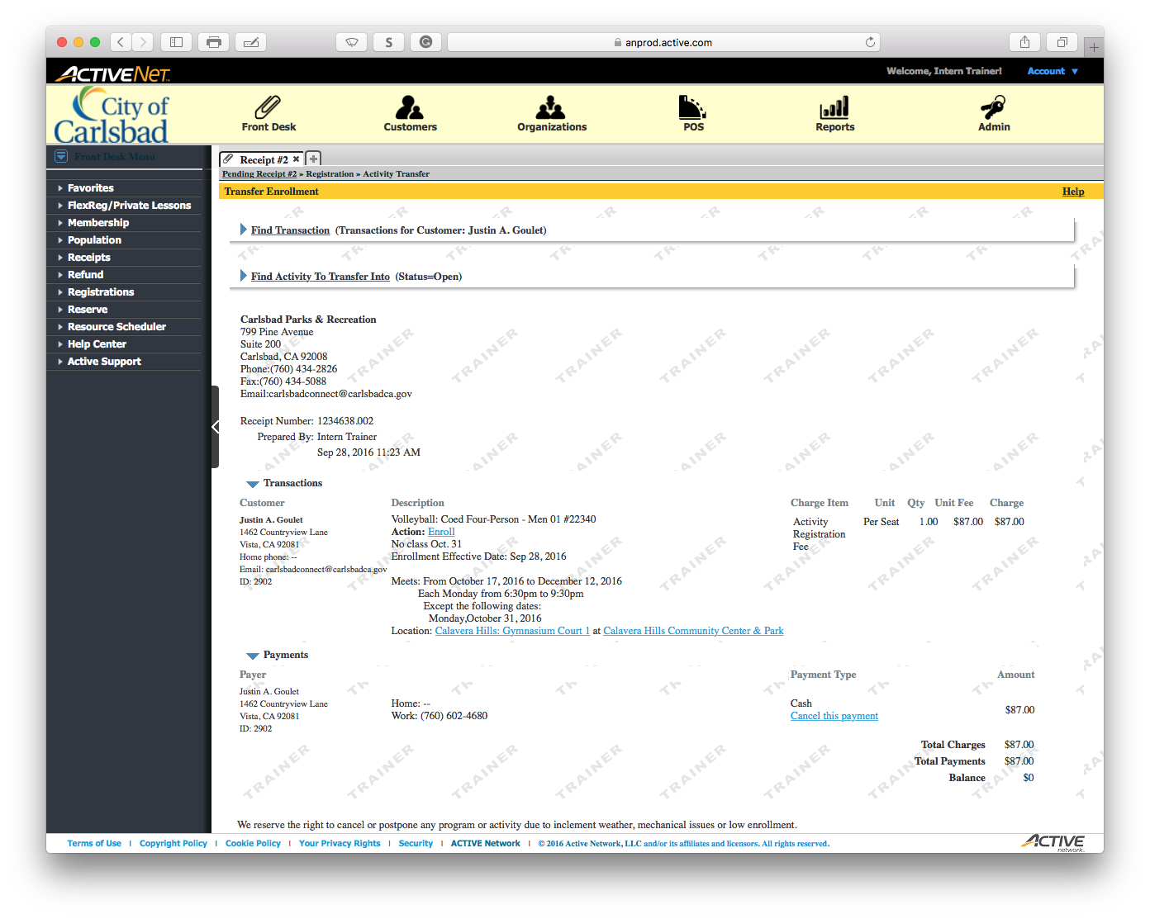
Main Text Instruction Will Go Here
Sub Instruction Here

Slide 11
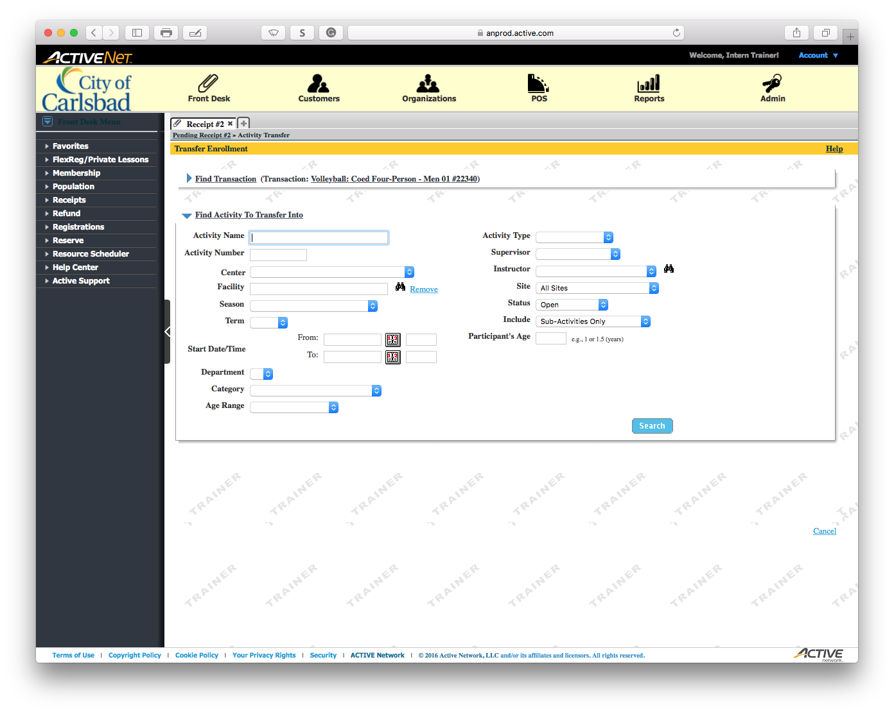
Main Text Instruction Will Go Here
Sub Instruction Here

Slide 12

Main Text Instruction Will Go Here
Sub Instruction Here

Slide 13
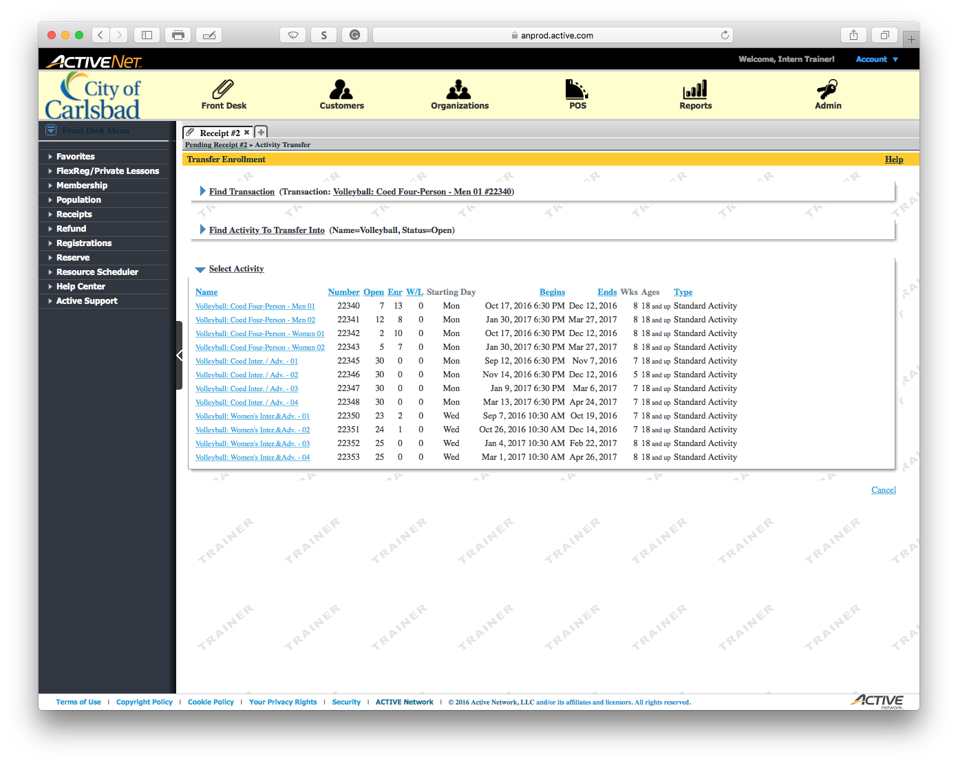
Main Text Instruction Will Go Here
Sub Instruction Here

Slide 14
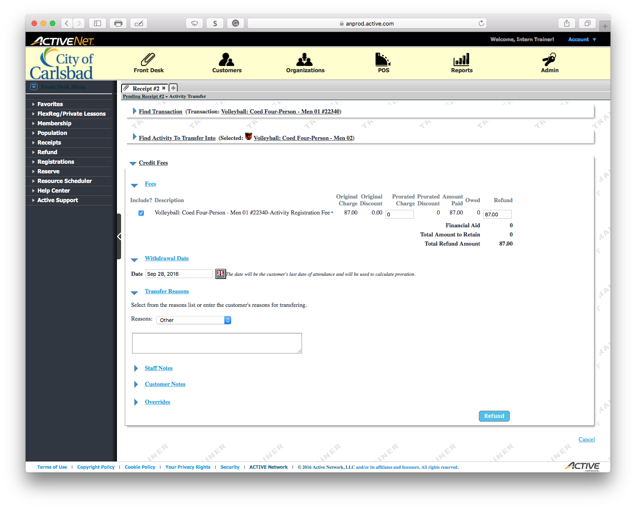
Main Text Instruction Will Go Here
Sub Instruction Here

Slide 15
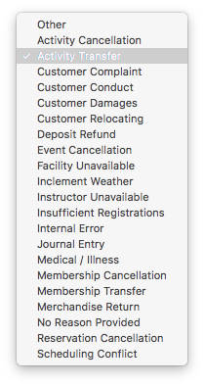
Main Text Instruction Will Go Here
Sub Instruction Here

Slide 16
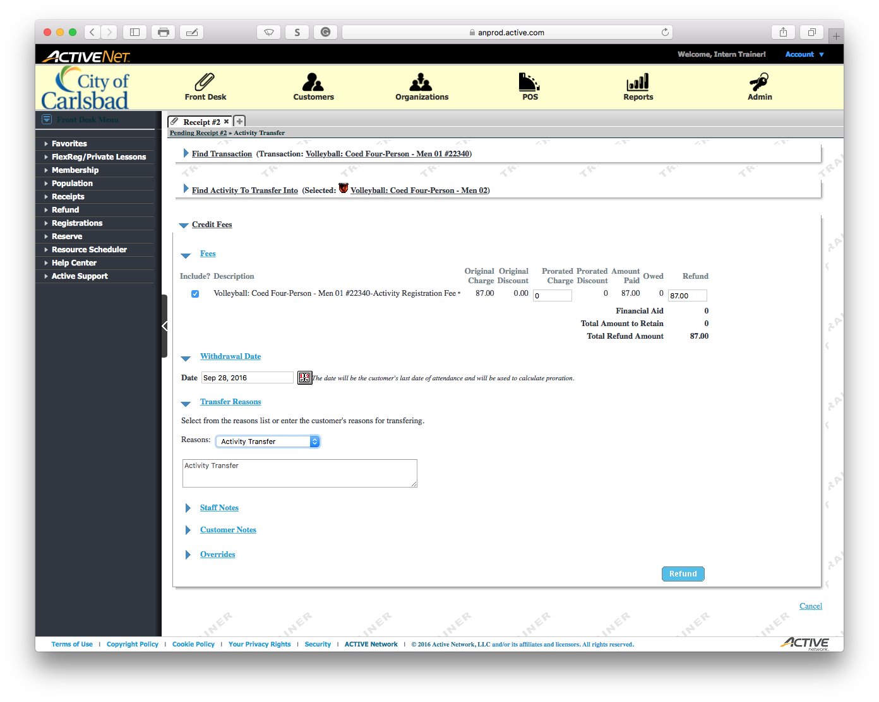
Main Text Instruction Will Go Here
Sub Instruction Here

Slide 17
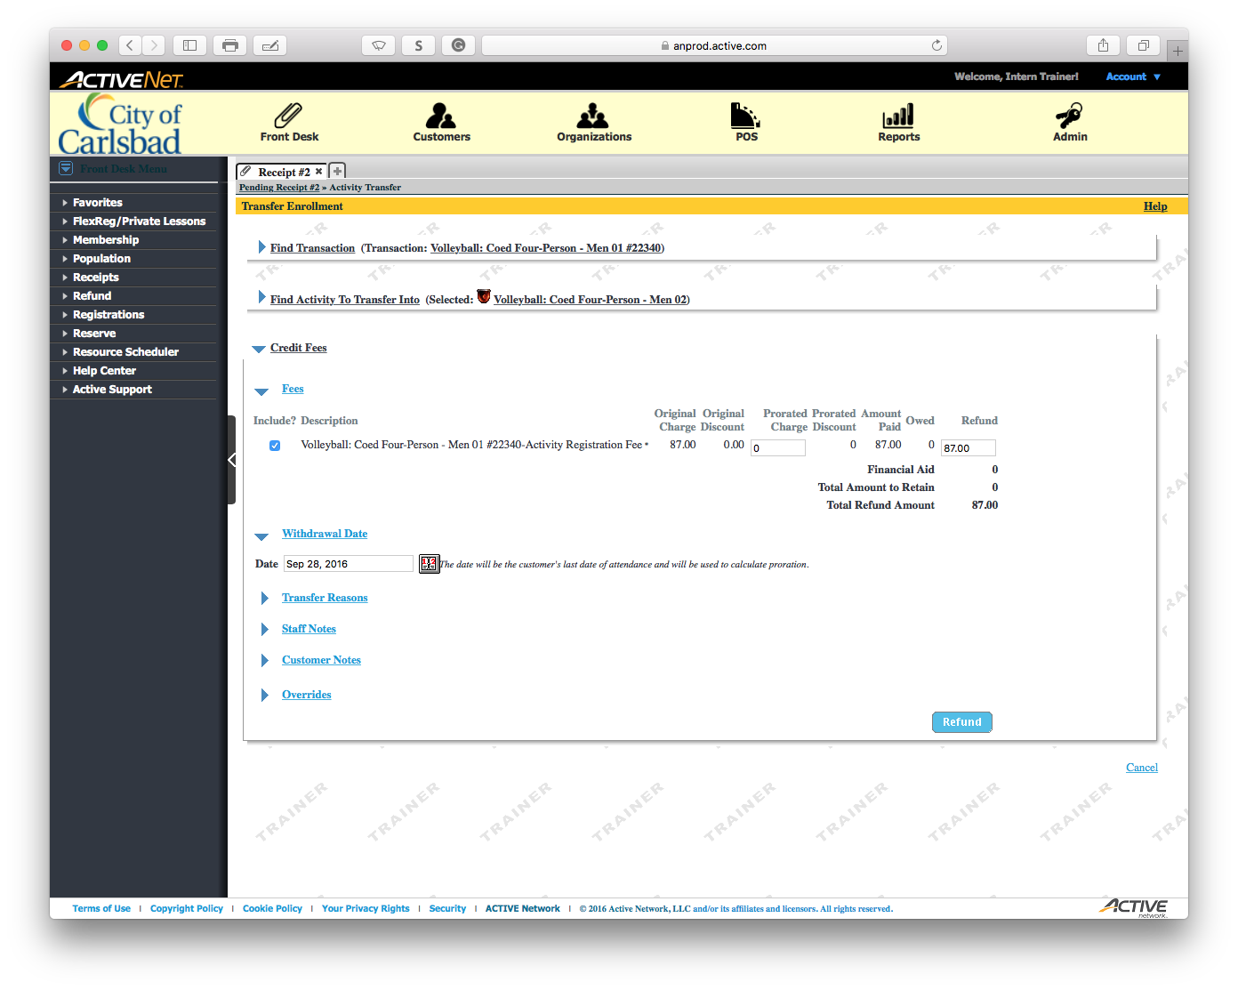
Main Text Instruction Will Go Here
Sub Instruction Here

Slide 18
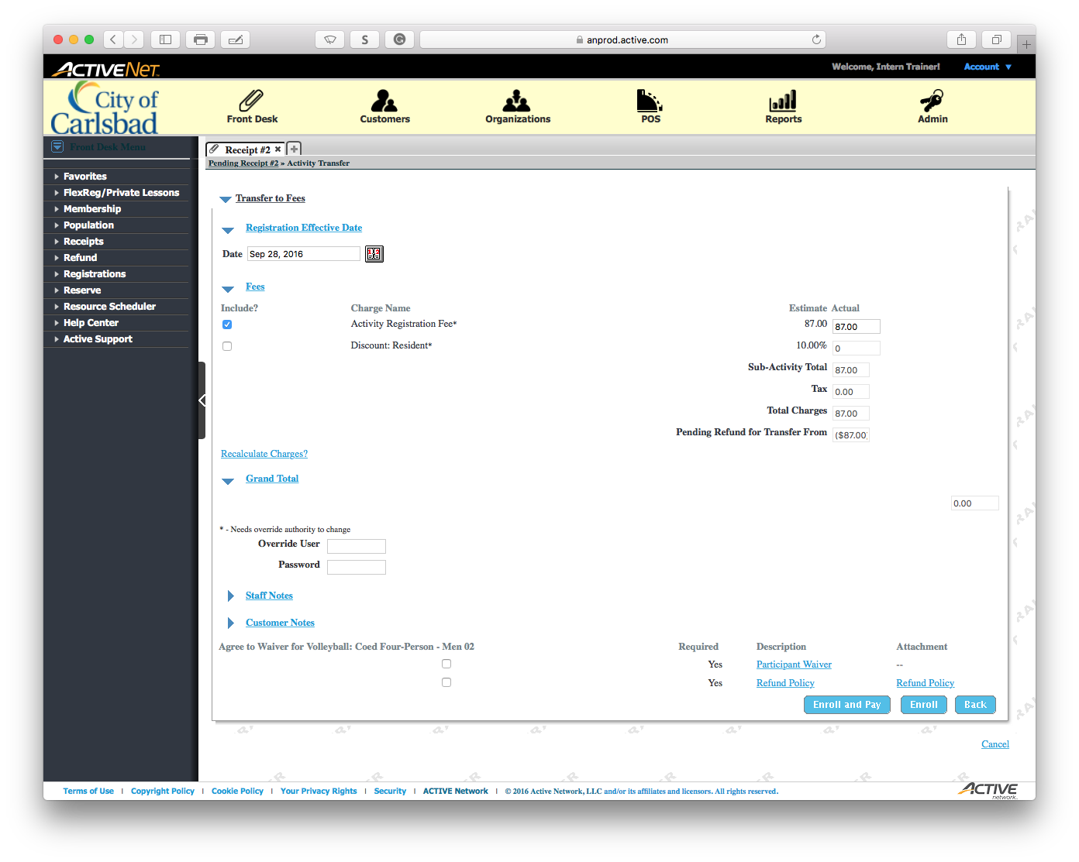
Main Text Instruction Will Go Here
Sub Instruction Here

Slide 19

Main Text Instruction Will Go Here
Sub Instruction Here

Slide 20

Main Text Instruction Will Go Here
Sub Instruction Here

Slide 21
Main Text Instruction Will Go Here
Sub Instruction Here

Slide 22
Main Text Instruction Will Go Here
Sub Instruction Here

Slide 23
Main Text Instruction Will Go Here
Sub Instruction Here

Slide 24
Main Text Instruction Will Go Here
Sub Instruction Here

Slide 25
Main Text Instruction Will Go Here
Sub Instruction Here

Slide 26
Main Text Instruction Will Go Here
Sub Instruction Here

Slide 27
Main Text Instruction Will Go Here
Sub Instruction Here

Slide 28
Main Text Instruction Will Go Here
Sub Instruction Here

Slide 29
Main Text Instruction Will Go Here
Sub Instruction Here

Slide 30
Main Text Instruction Will Go Here
Sub Instruction Here

Slide 31
Main Text Instruction Will Go Here
Sub Instruction Here

Slide 32
Main Text Instruction Will Go Here
Sub Instruction Here

Slide 33
Main Text Instruction Will Go Here
Sub Instruction Here

Slide 34
Main Text Instruction Will Go Here
Sub Instruction Here

Slide 35
Main Text Instruction Will Go Here
Sub Instruction Here

Slide 36
Main Text Instruction Will Go Here
Sub Instruction Here

